Slide 1
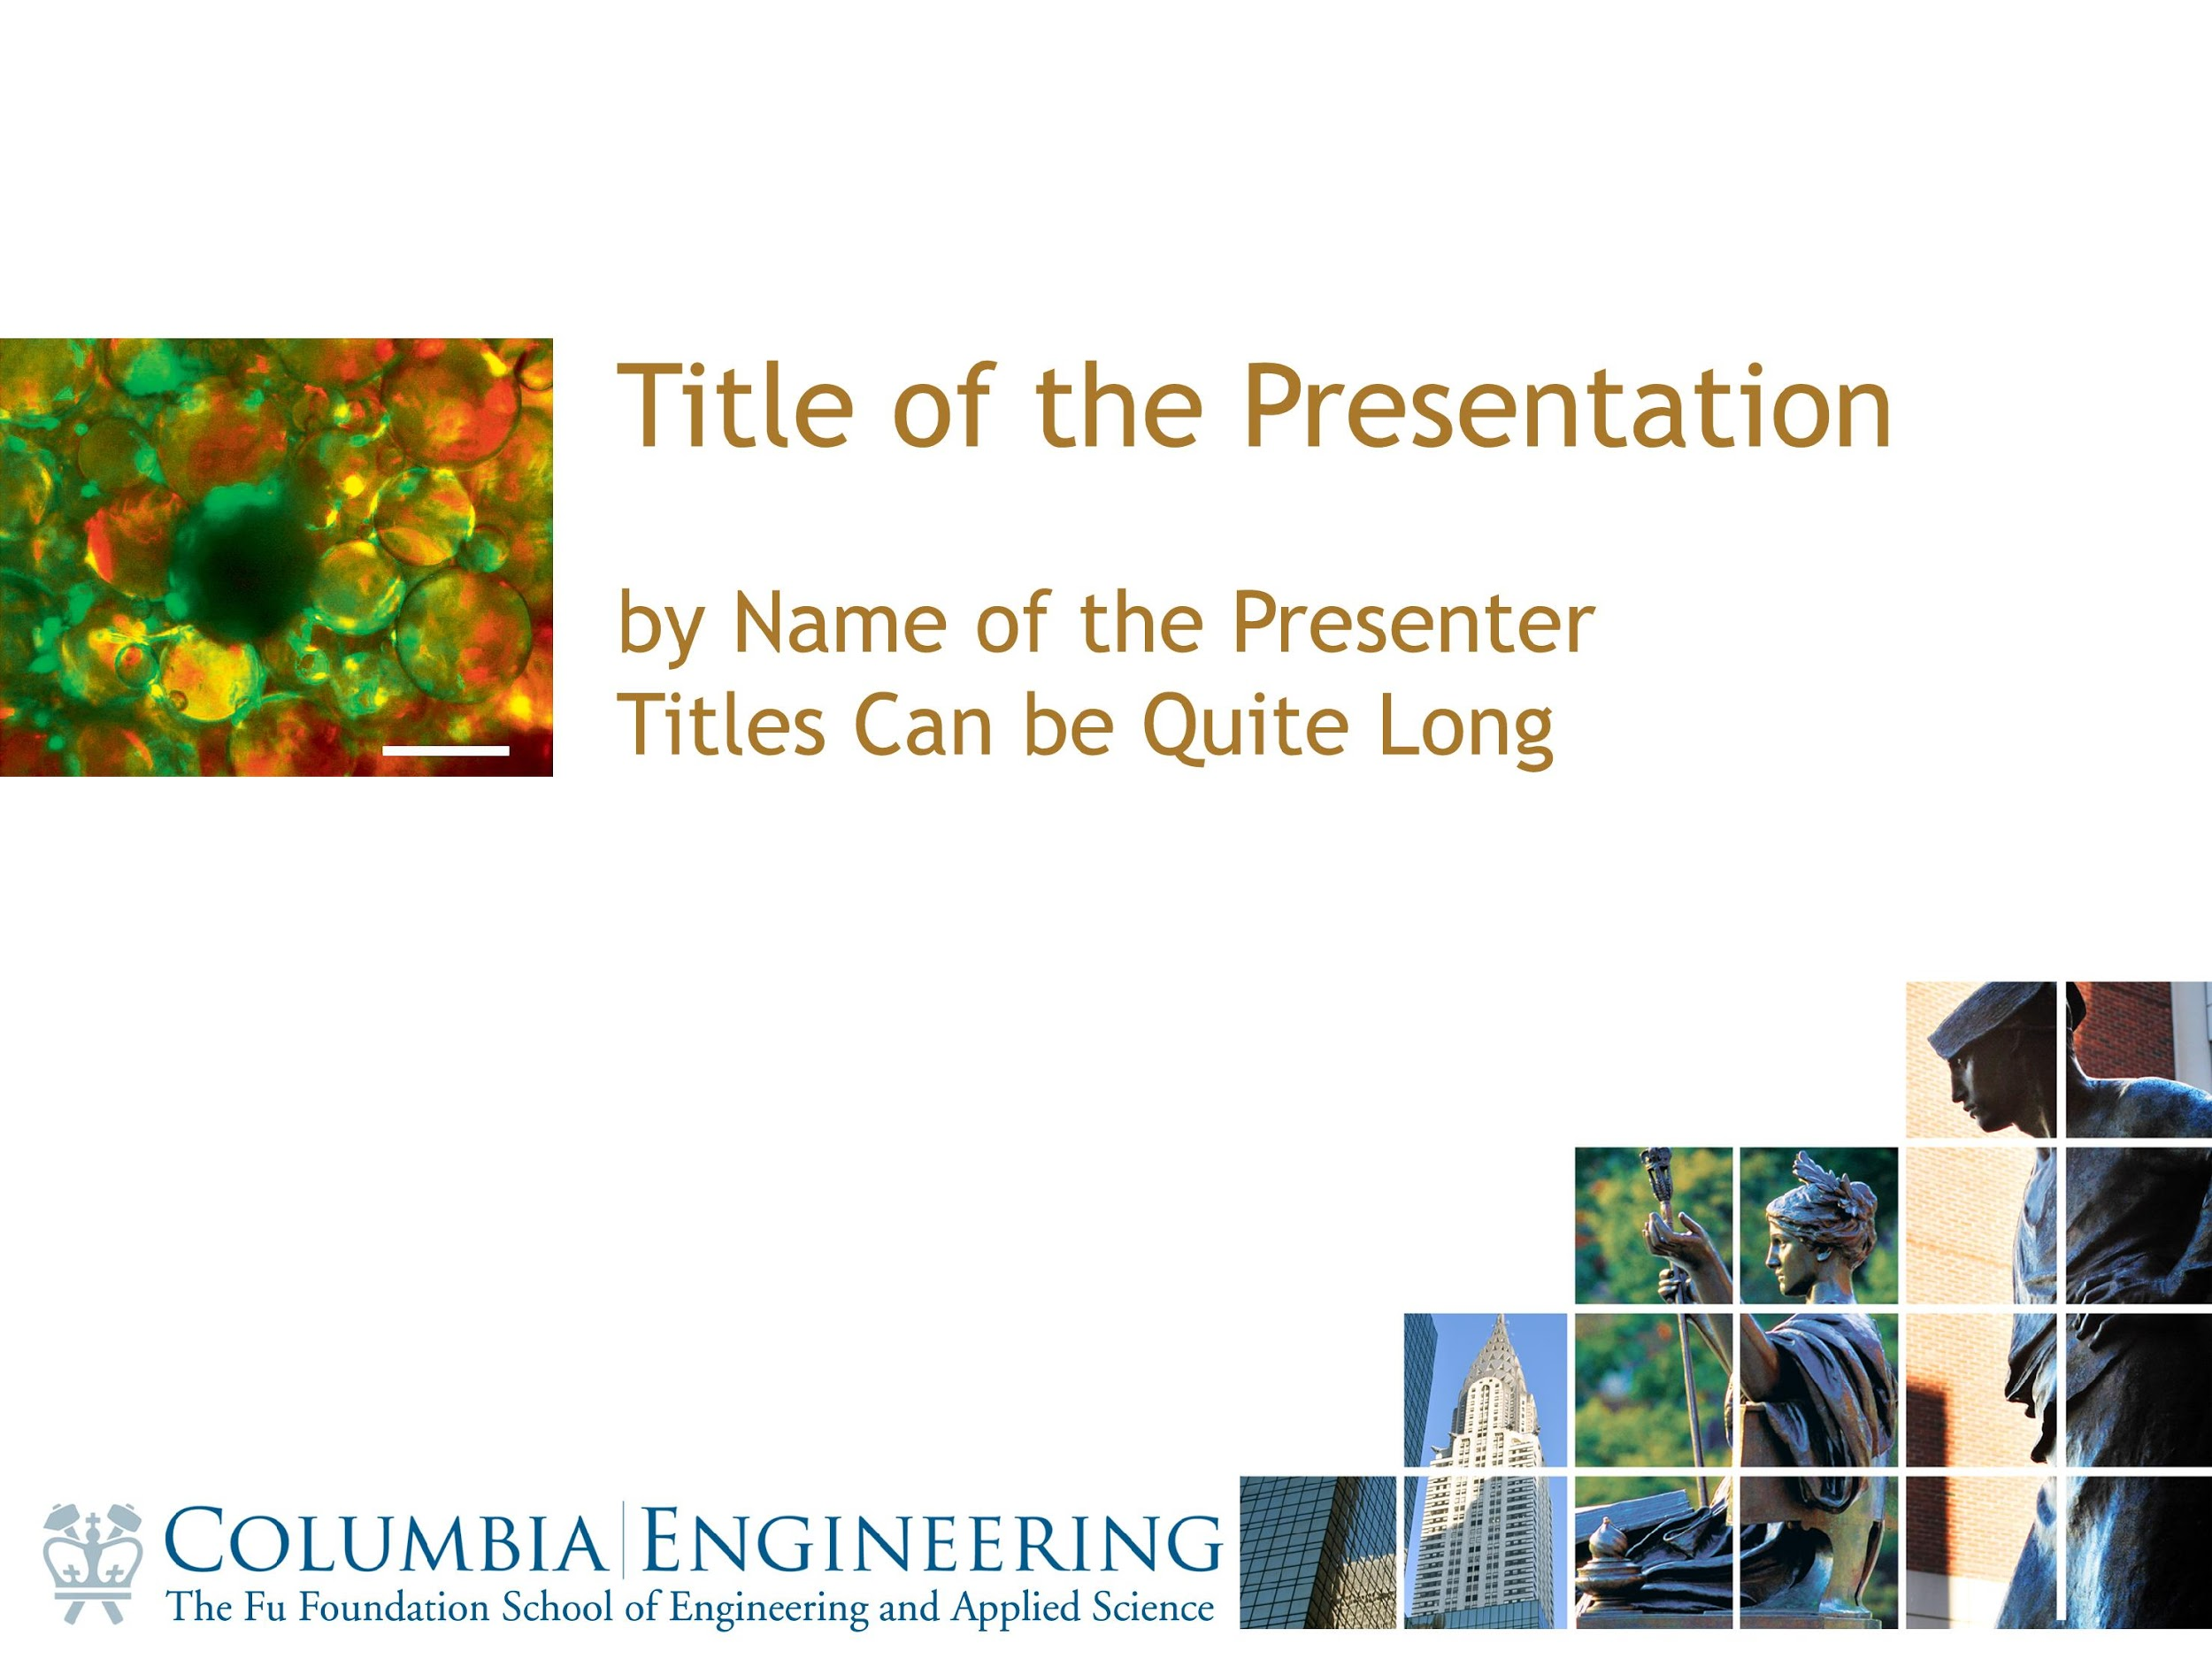
Photonics-Empowered Computing
— From Efficient to Functional Data Movement
Yuyang Wang
Postdoctoral Research Scientist, Columbia Nano Initiative
Columbia University in the City of New York, New York, NY 10027
🖂 yw3831@columbia.edu
January 10, 2025

Slide 2
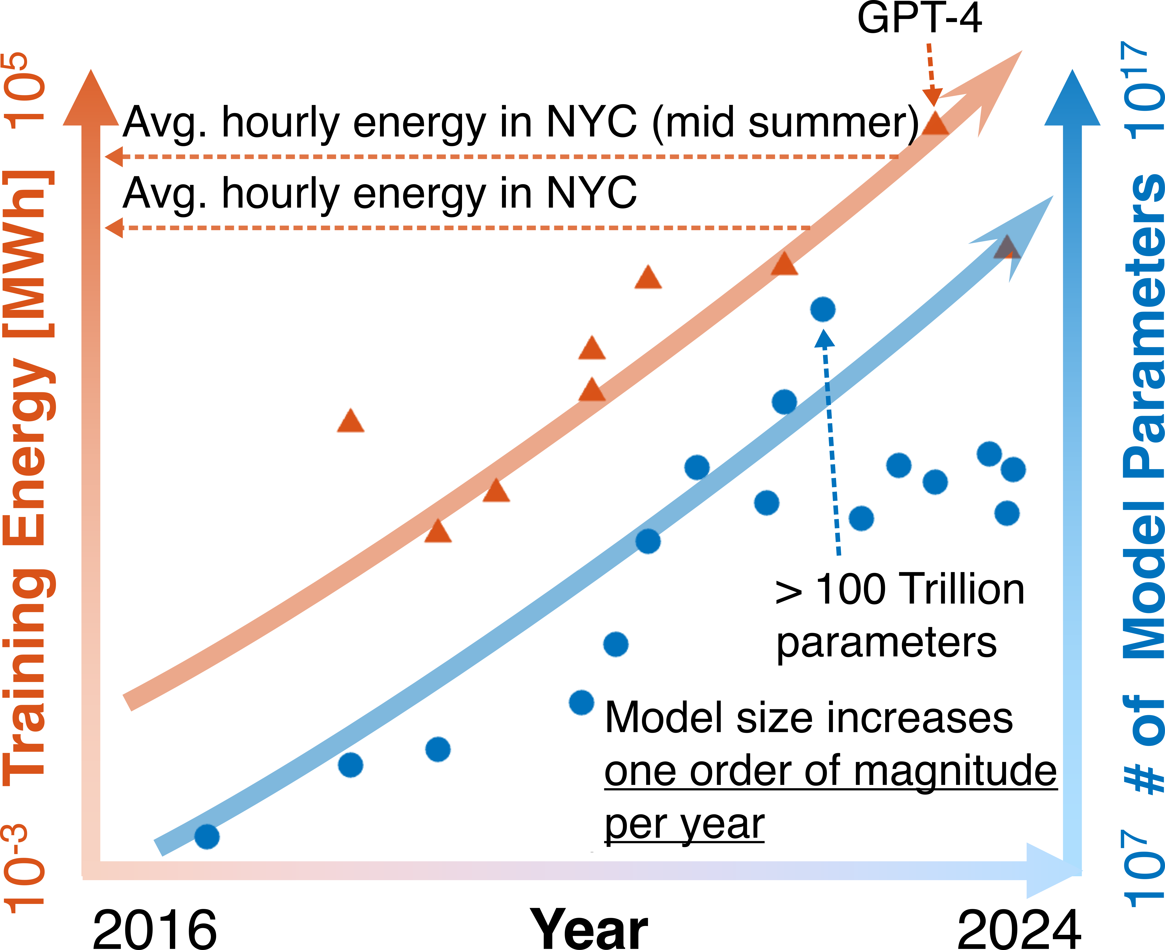
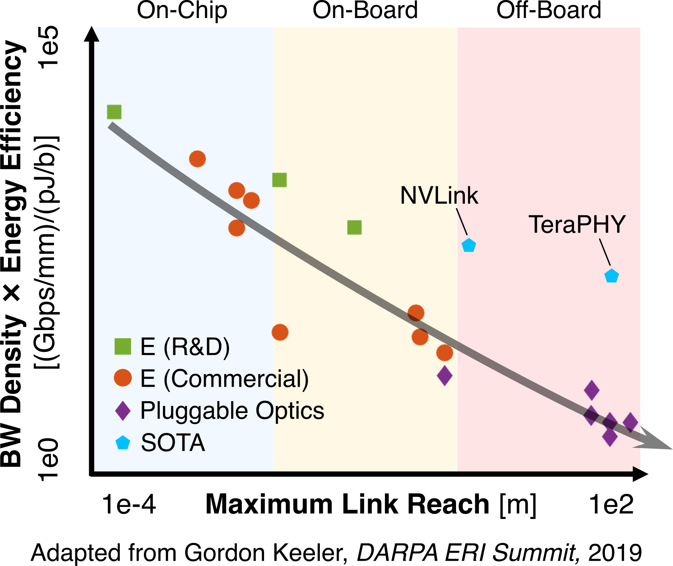
Challenges Moving Data Off-Chip
Embedded Photonics
Future Goal
Y. Wang, et al. IEEE T-CPMT, 2024

Slide 3
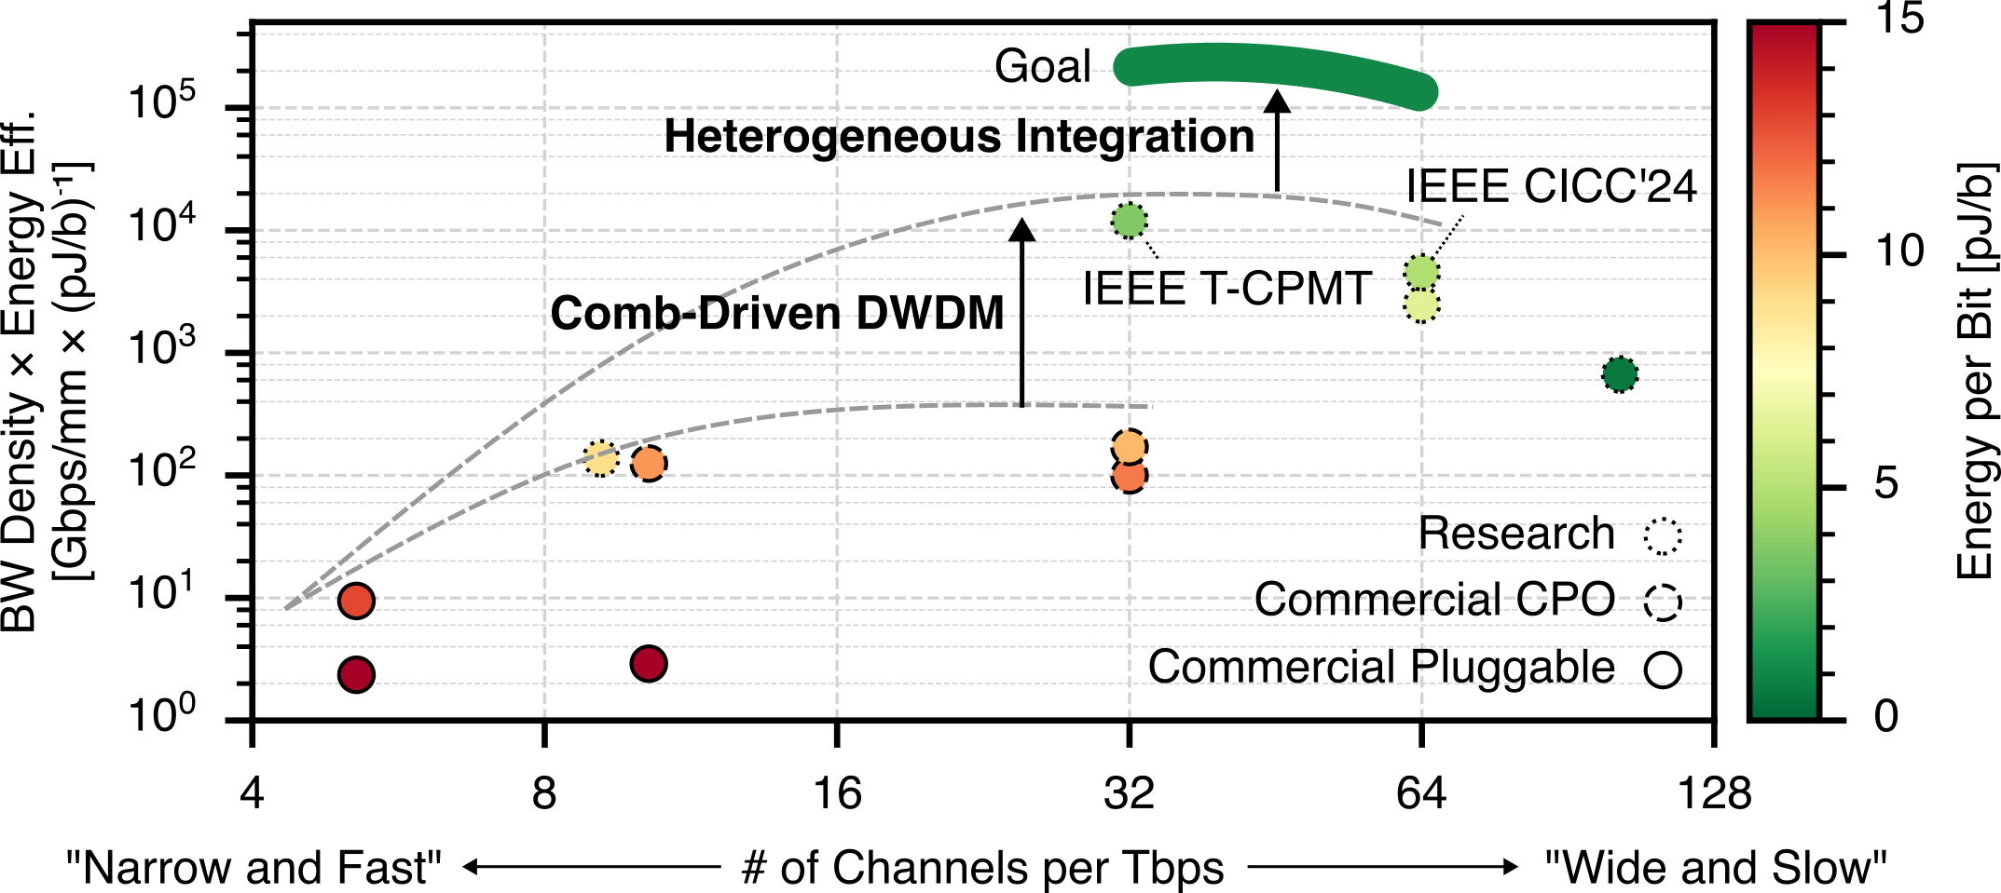
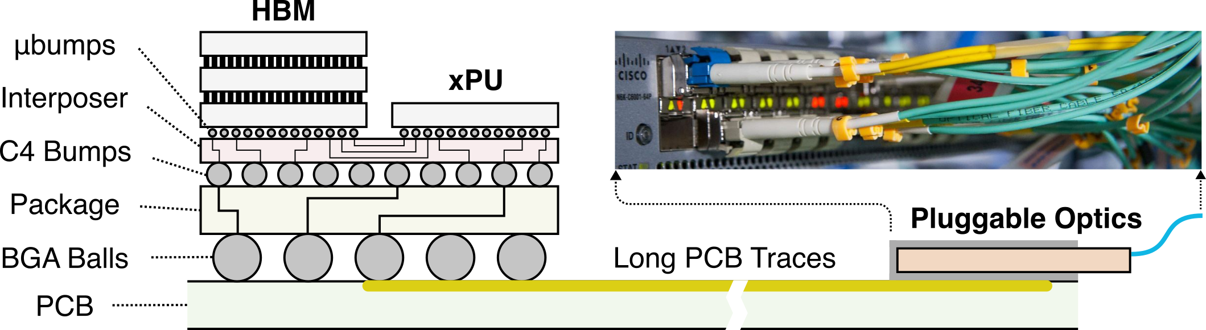
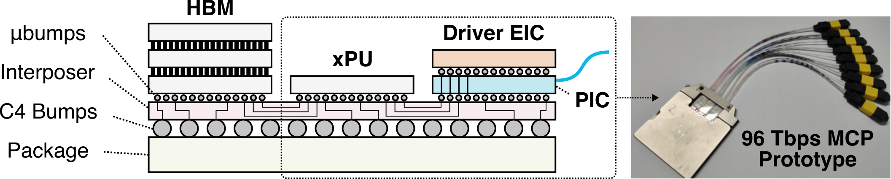
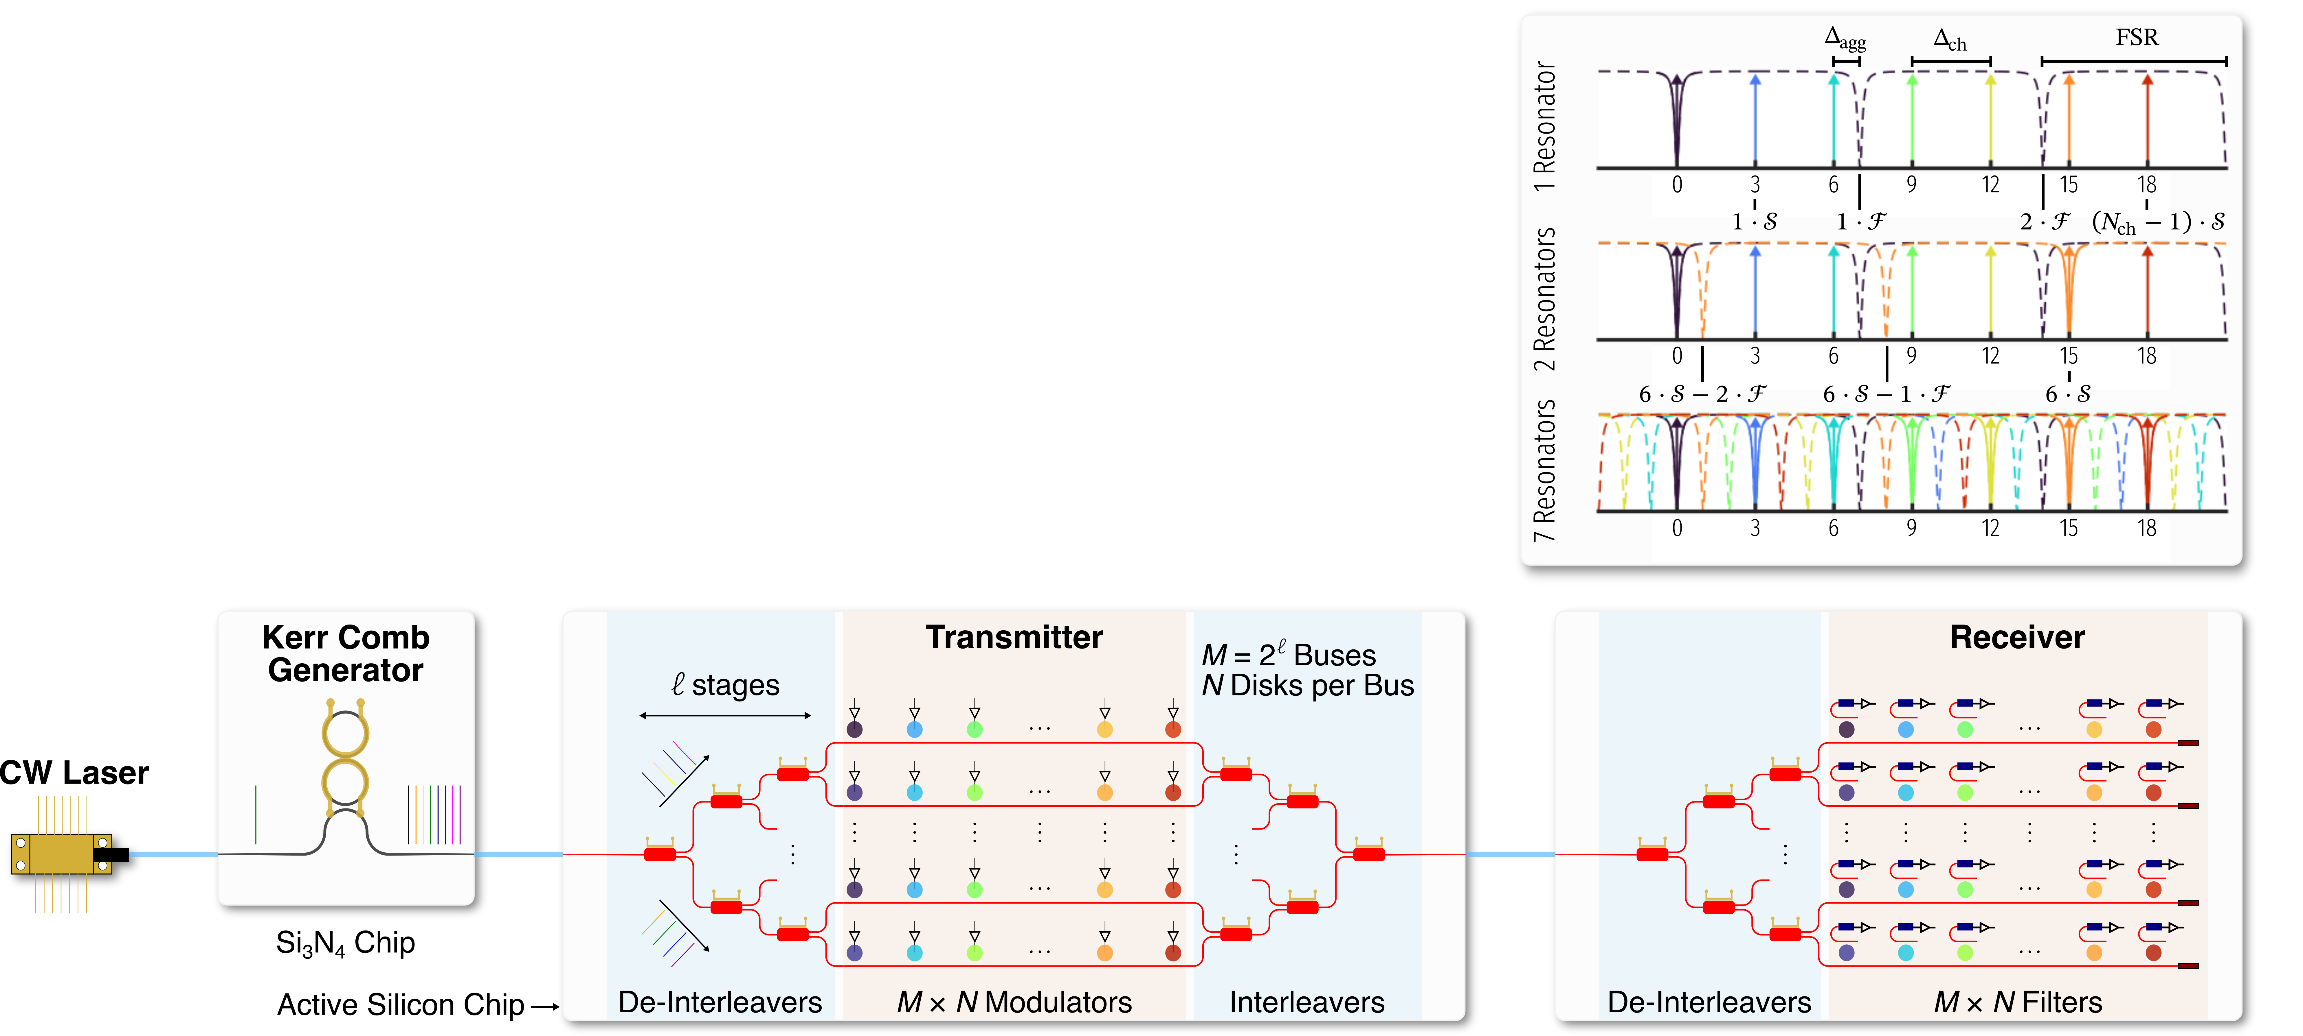
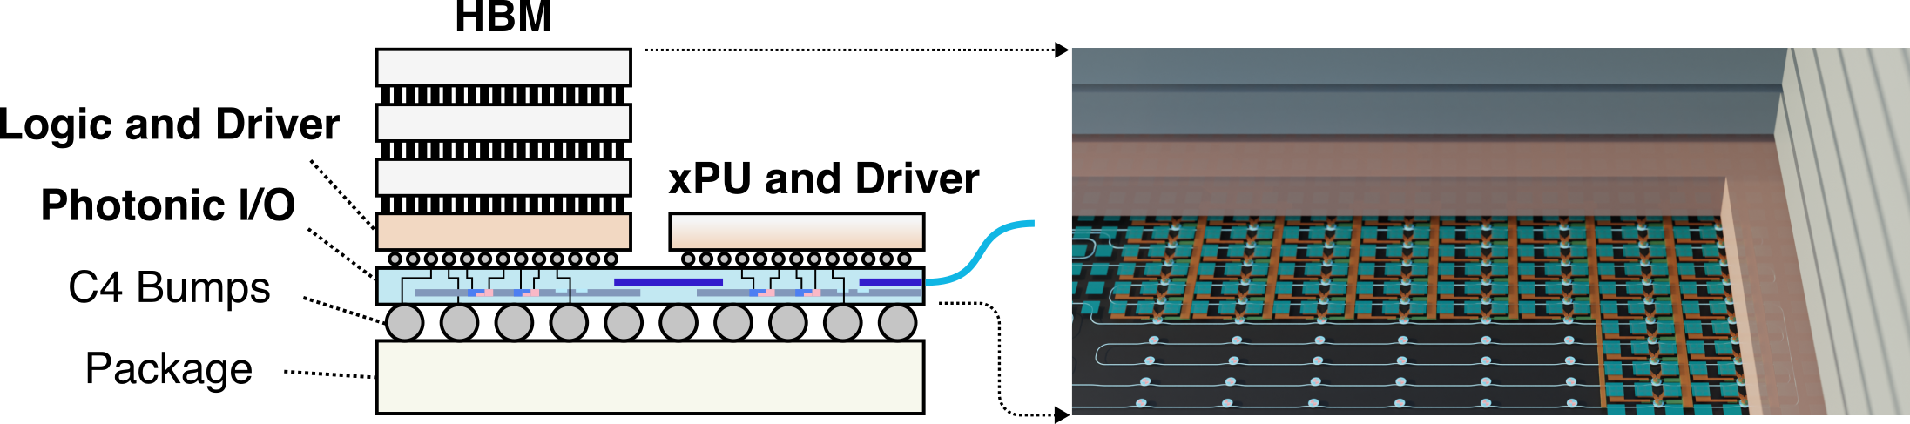
Embracing Parallelism and Heterogeneous Integration
Scalable link architecture > 64 channel/fiber

Slide 4
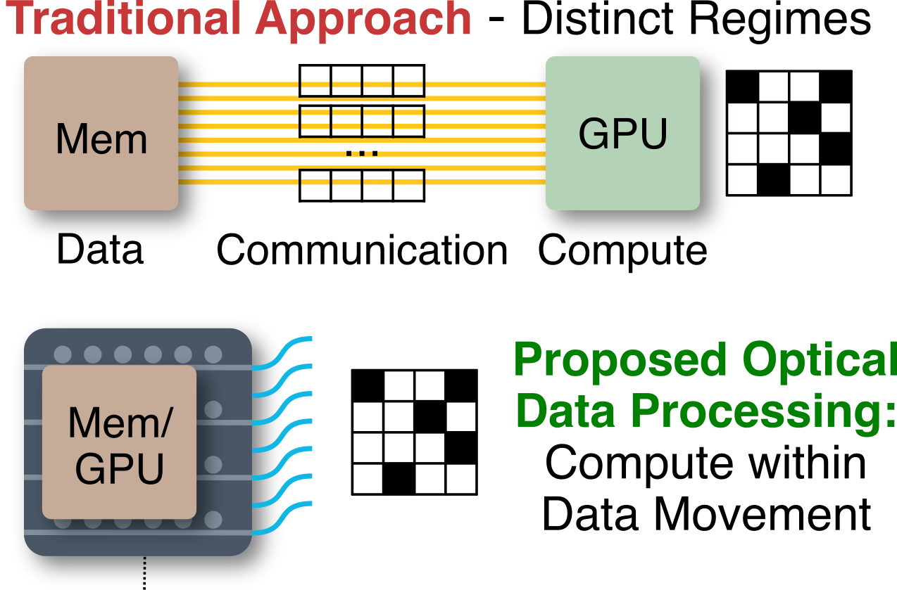
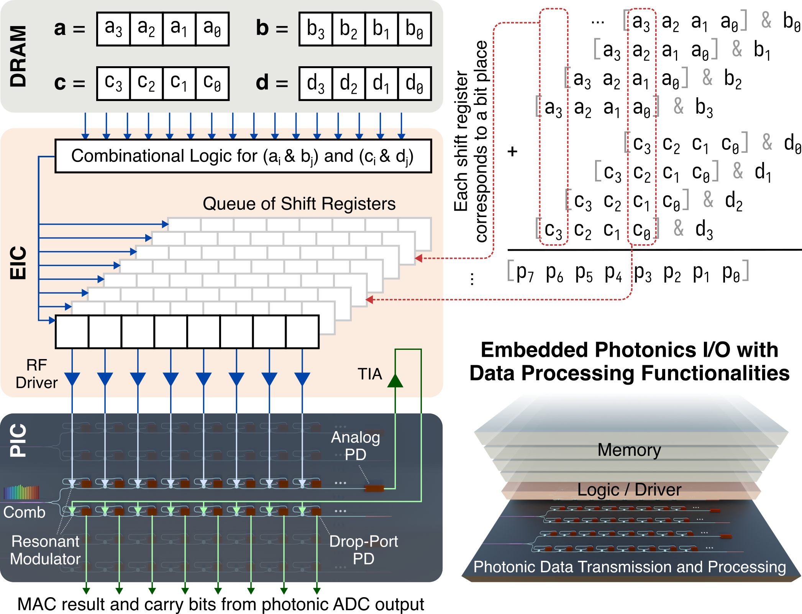
Compute Within Data Movement
Bridging computing/communication regimes
Improved bit precision and robustness
New optically connected memory architecture
Applications in other domains, e.g., RF antenna arrays
N. Nauman, Y. Wang, et al. OFC 2025

Slide 5
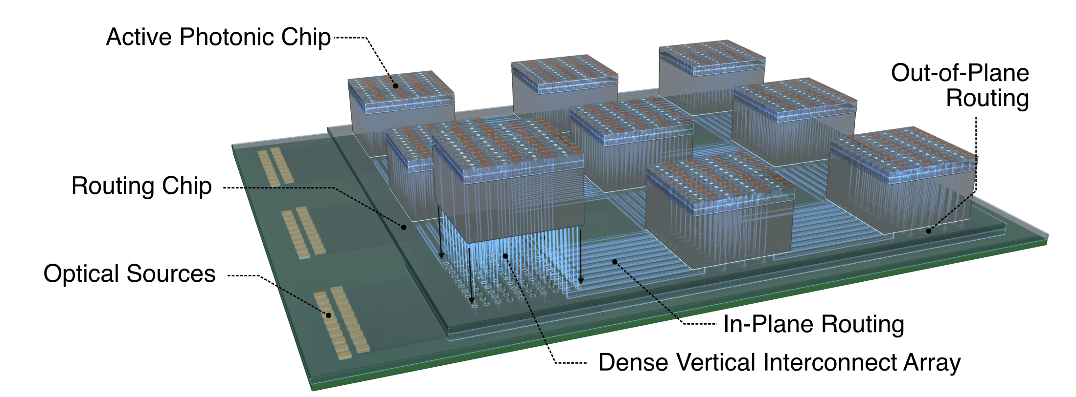
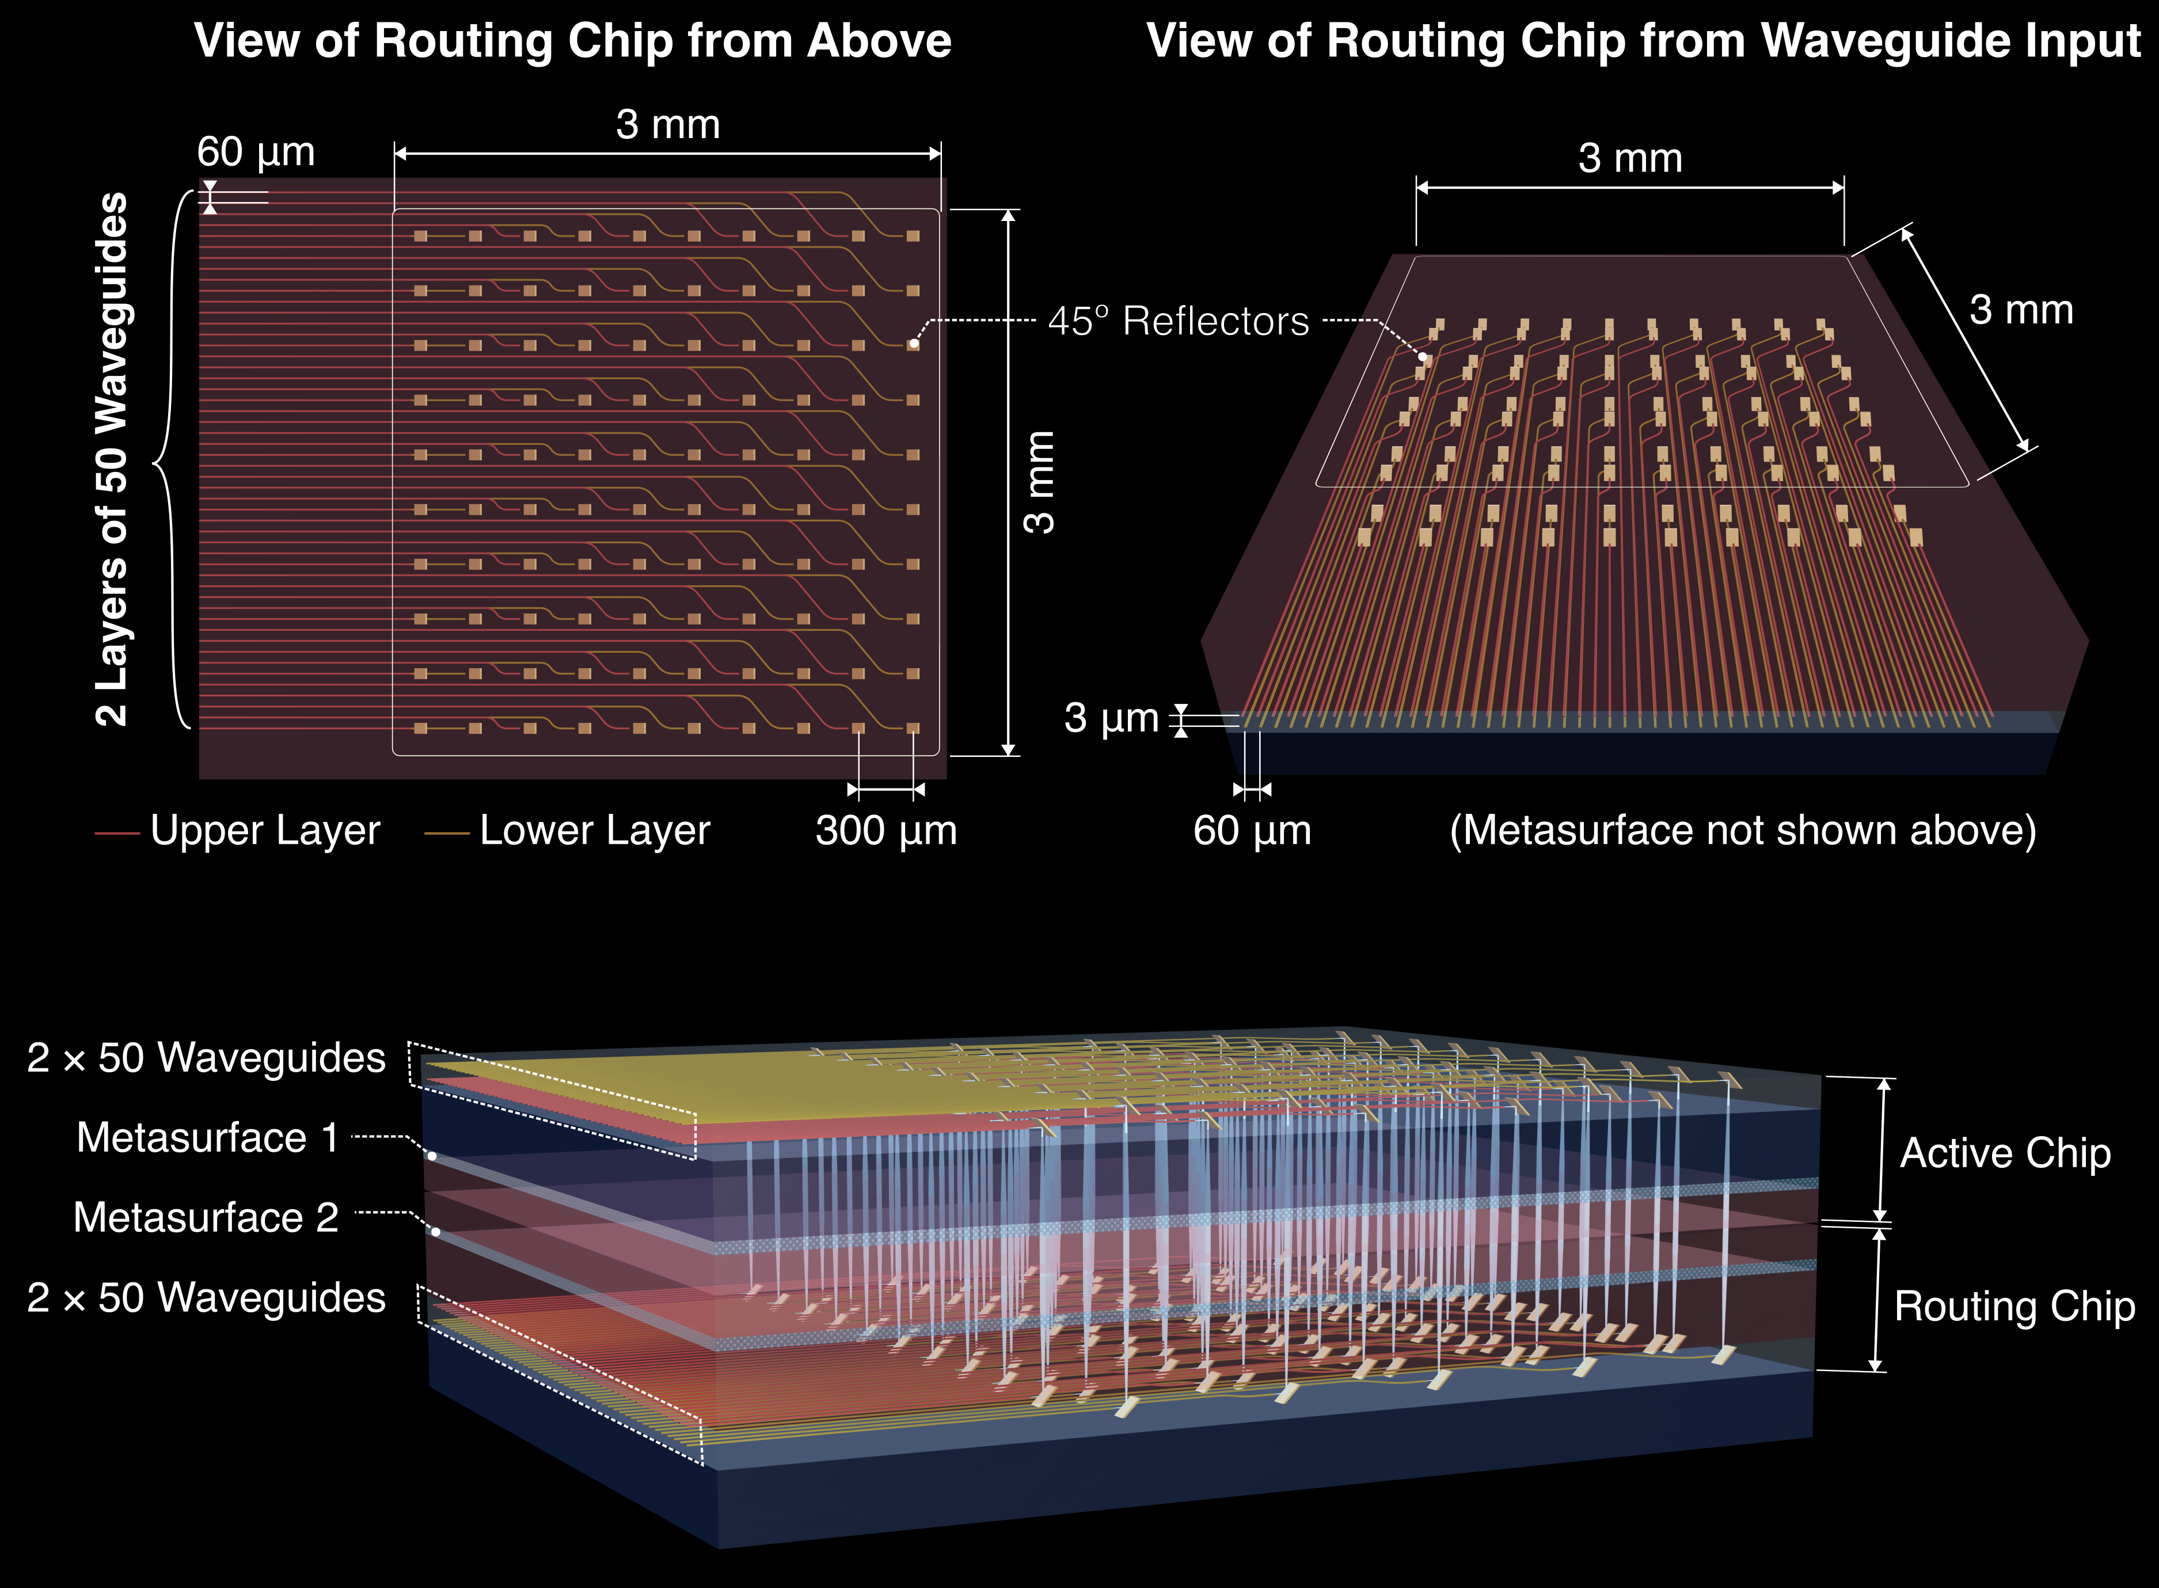
Photonics in Third Dimension
New materials, advanced packaging
Overcome planar photonics limitations
Inter-disciplinary collaboration opportunities: material, device, packaging, computing system, design automation, digital twins.

Slide 6
Summary
Integrated photonic systems where optical interconnects are not just high-bandwidth communication channels but also platforms for distributed computing.
Cross-disciplinary collaboration to develop an ecosystem around this vision.

